Slide 1

Port Scanning

Slide 2
Ports are communication endpoints that enable computers to send and receive data over a network.
Ports are softwarebased(virtual) and managed by a
computer's operating system. Each port is associated with a specific process or service. Ports allow computers to
easily differentiate between different kinds of traffic ( Web , Email …..)

Slide 3
Port scanning is a technique used to identify open ports on a computer or network device.

Slide 4
The purpose of this program is to automate the process of port scanning using Python Library (SOCKET) instead of using the traditional way of CLI.

Slide 5
CLI Method:
1-check the server ( destination) is up and running
2-check the network availability and reachability between the client (my pc) and the server
using ICMP Protocol (Ping command)
-> taking google as an example:
open CMD Window

Slide 6
-if it is well known to DNS and its name could be resolved we use the name if not we use the IP
Google.com -> 216.58.204.238
-if it came with reply , then we have passed the first two steps we follow with the next step ( port scanning )

Slide 7
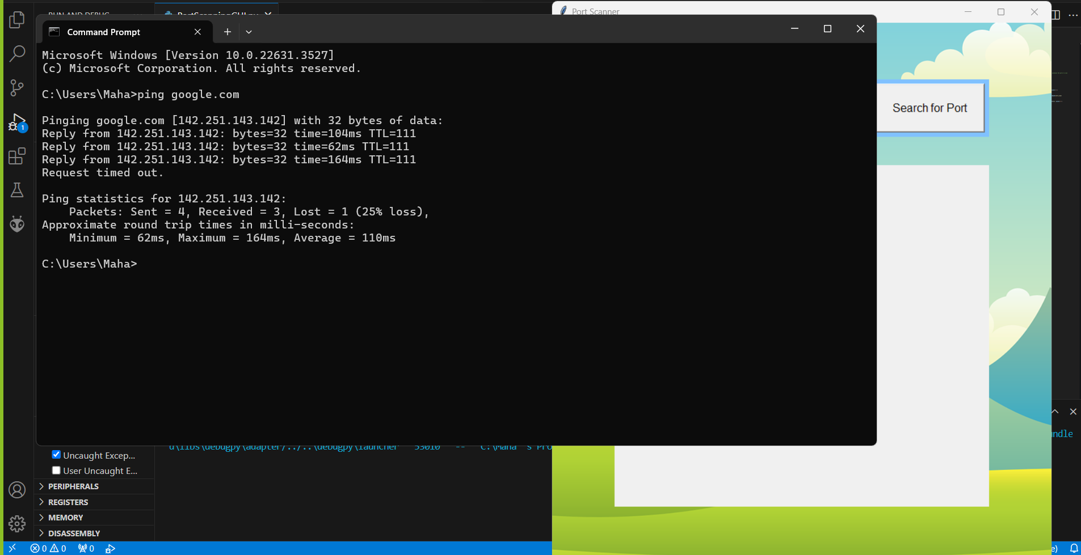

Slide 8
on windows we cannot use ping command to check on the port availability , maybe on linux or kali would be available.
Instead we use telnet command with specifying the dest. port
we start by scanning well known ports like

Slide 9
Well Known Port number:
21 FTP ( DAta Transfare )
22 SSH ( Network device communication )
23 Telnet ( Network device com21 FTP ( DAta Transfare )
22 SSH ( Network device communication )
23 Telnet ( Network device communication )
25 SMTP ( mail )
49 TACACS ( Centeral Authentication Server )
53 DNS
80 HTTP
110 PoP3
443 HTTPS
465 SMTP TCP
3389 RDP (Remote desktop connection)munication )
25 SMTP ( mail )
49 TACACS ( Centeral Authentication Server )
53 DNS
80 HTTP
110 PoP3
443 HTTPS
465 SMTP TCP

Slide 10
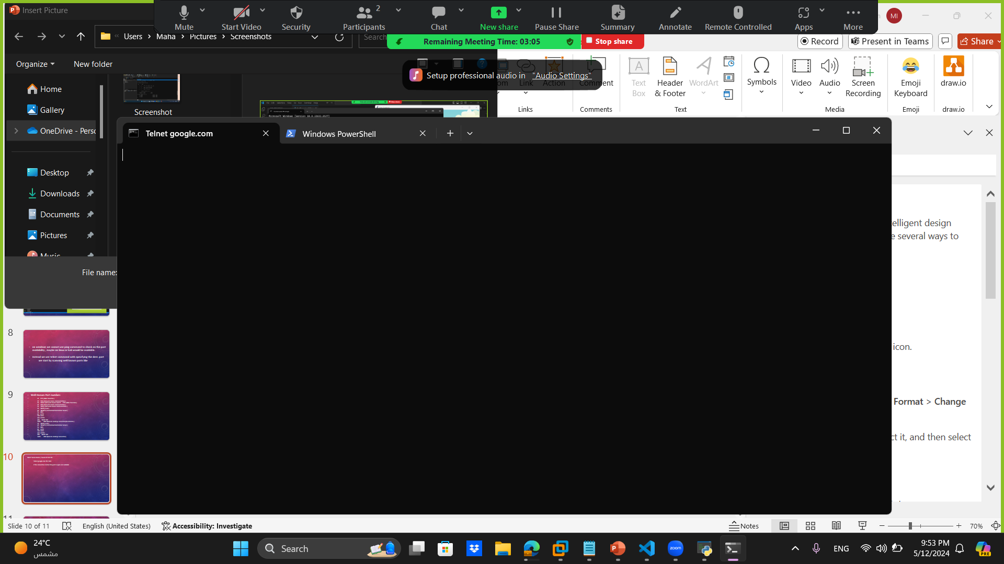
Telnet Server Name / Server IP Port No.
Telnet google.com 80 / 443
if the connection started the port is open and avilabile

Slide 11
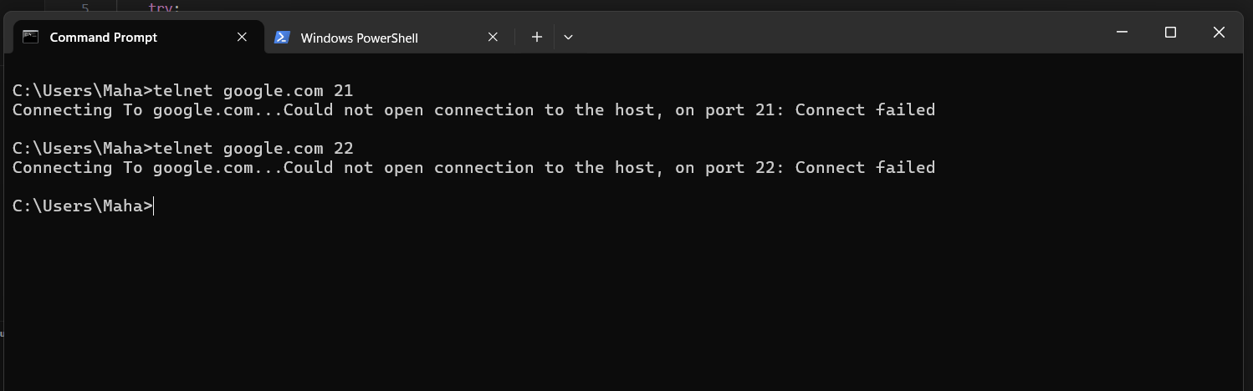
Telnet Server Name / Server IP Port No.
Telnet google.com 21 / 22
if the connection did not start then the port is closed

Slide 12
in order to automate the code we are using python code
- we started by importing two main library Socket and tkinter

Slide 13
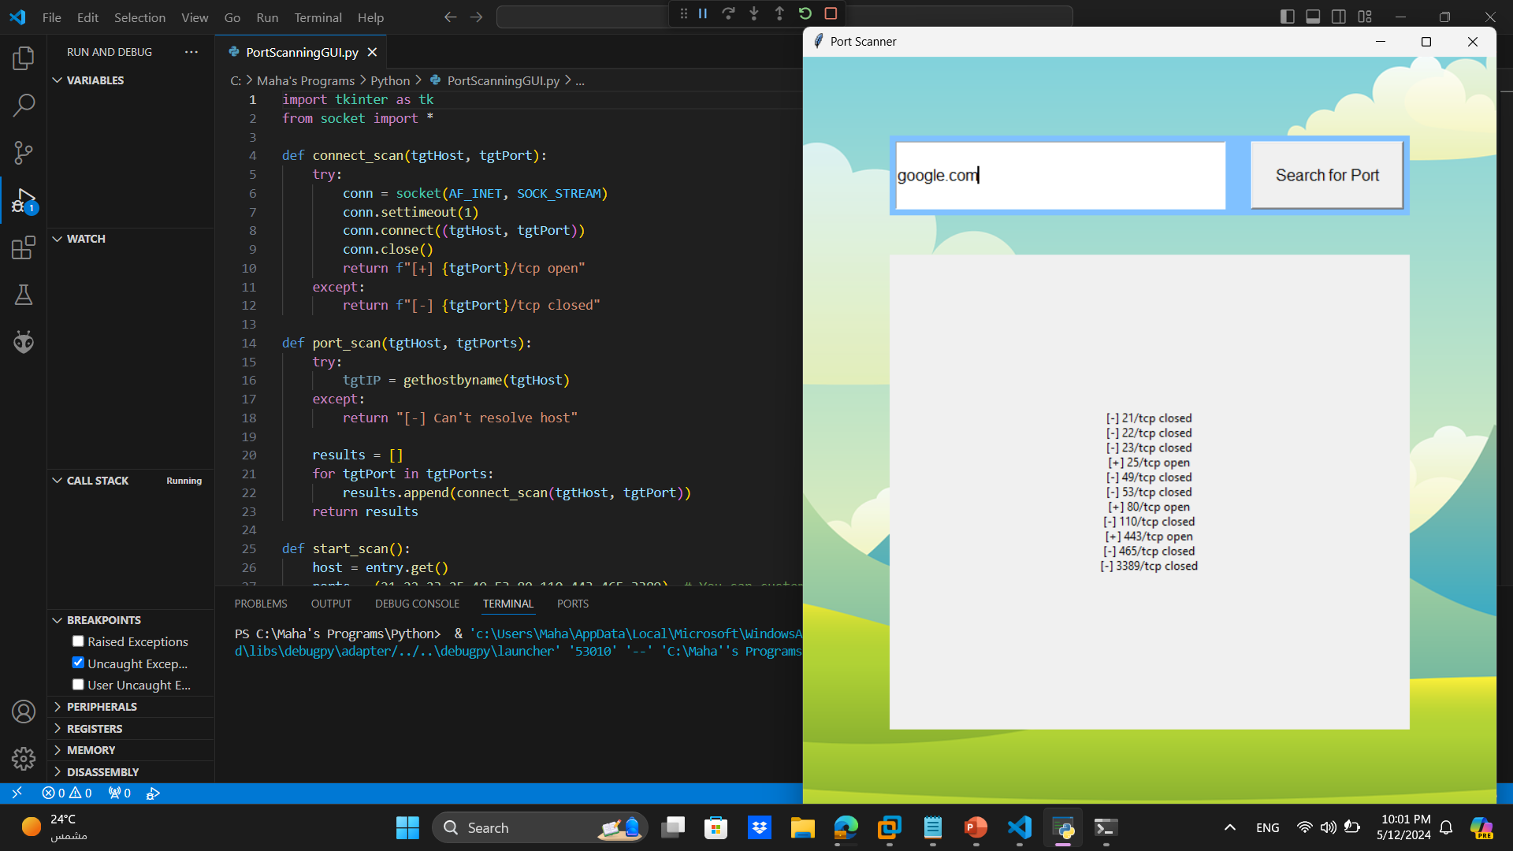

Slide 14

Thank You!
someone@example.com

